Slide 1

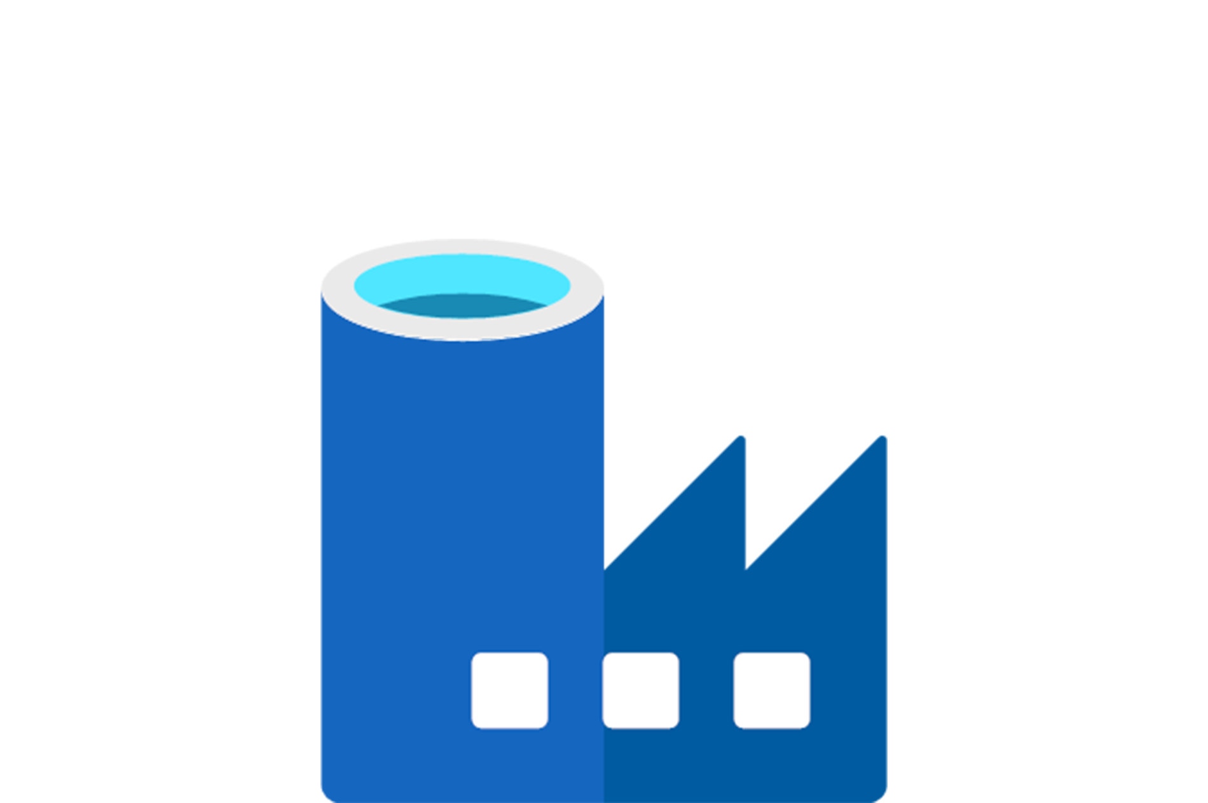
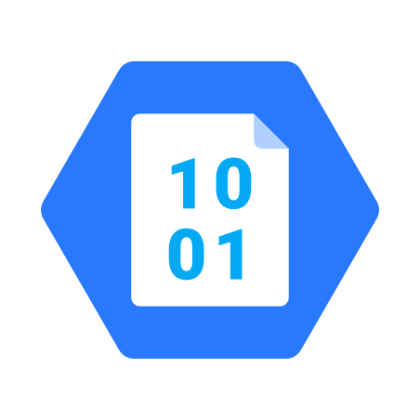
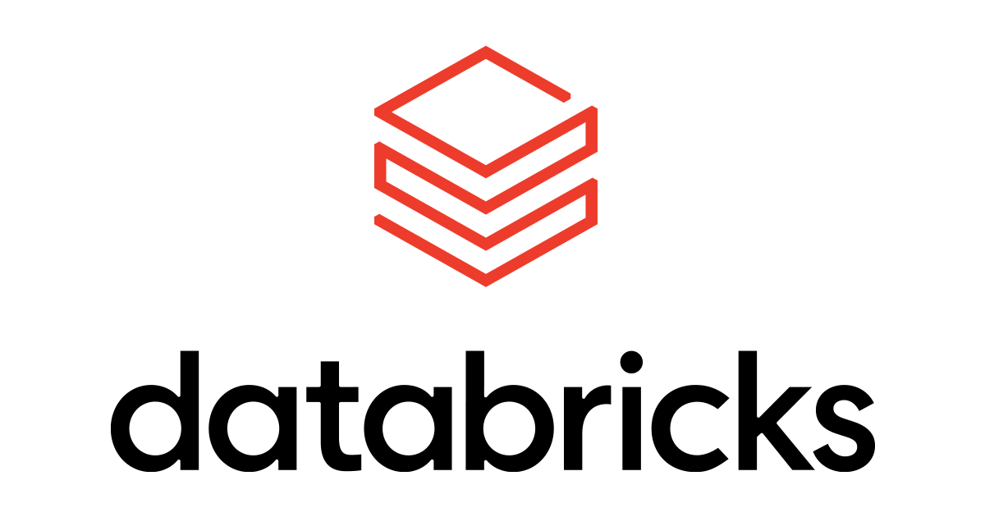

Real-Time projects
Project1: Smart Vehicles
Project2: AP Morgan Data Platform
Presented by:
Name : Sai Kiran Anche
Reg No: DXC262AB12021

Slide 2
Contents:
Introduction.
Project Overview
Client Requirements
Project Deployments
Project Outcomes
Result
Conclusions

Slide 3
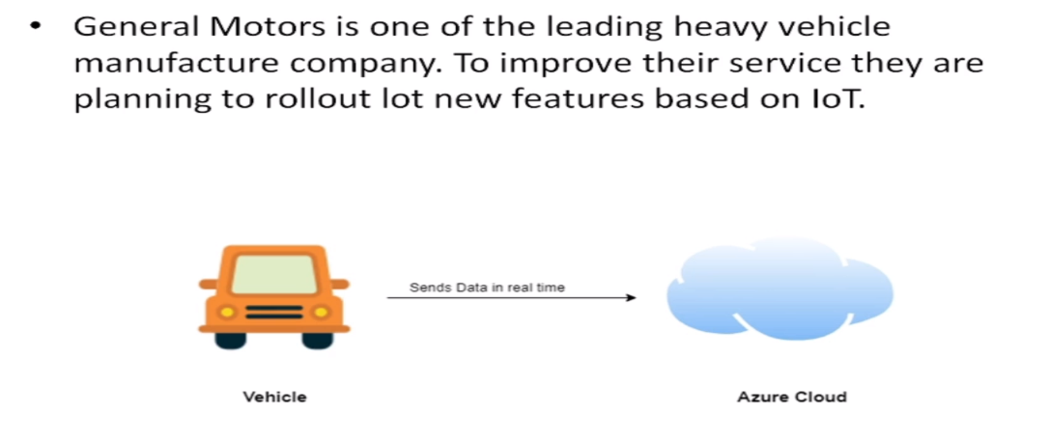
Project -1

Slide 4
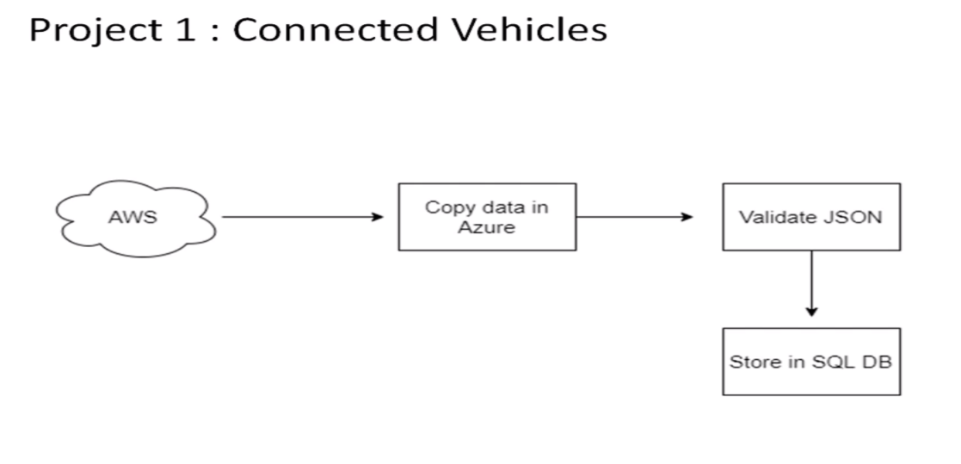
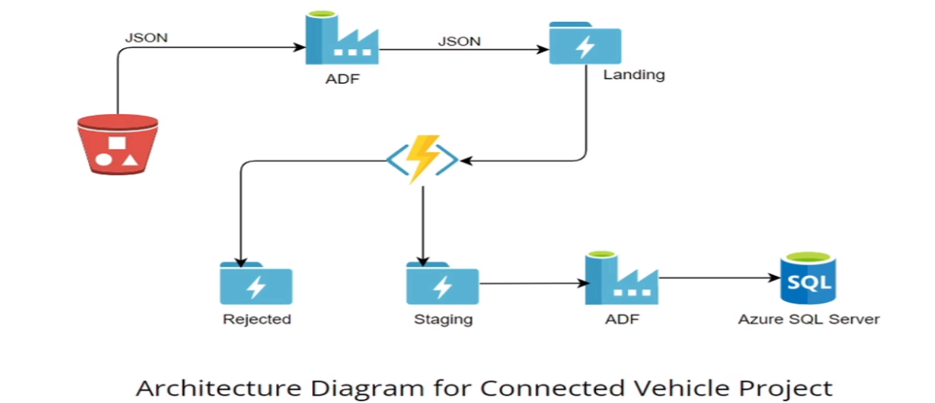
Project Overview
Vehicle has third party loT device which will send the telemetry data (in JSON format) over the AWS cloud.
You need to move data from third party AWS to General Motors Azure cloud.
You need to validate the JSON sometime it could be incomplete or wrong JSON which need to be rejected.
Once JSON got validated this data would be stored in the SQL database which will be further utilized by data science team.

Slide 5
Client requirements :
Azure Data Factory Account For Data pipelines.
ADF Pipeline End to end pipeline with triggers enabled
Azure blob trigger logic
Azure SQL Server and Database
Pipelines for moving data from Staging to SQL DB

Slide 6
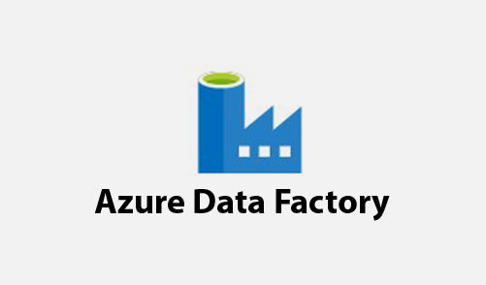
What is a data Factory? :
It serves as an Orchestrator.
It is an ETL tool.
It is a data integration service.
It will deliver extraction , transformation and loading process with in the cloud.
Can be used to connect with different data bases within the cloud.

Slide 7
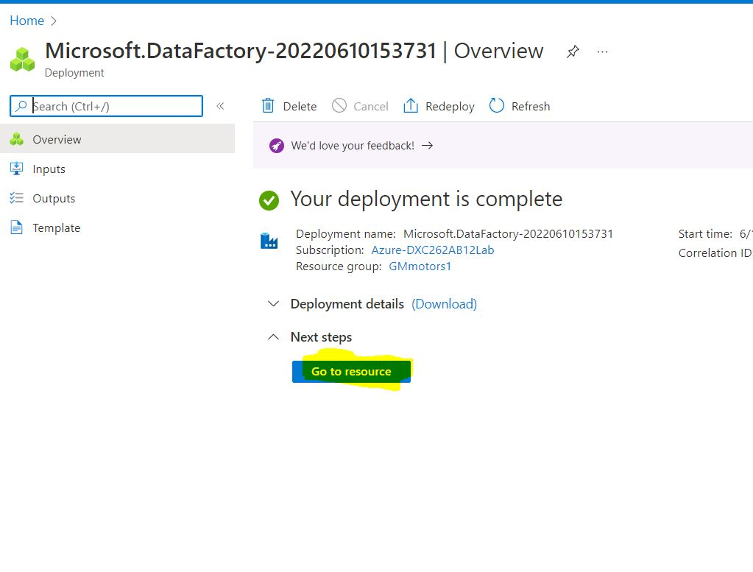
Practical Lab: Create Azure Data Factory Account For Data pipelines:
Step1: Go to the URL: portal.azure.com and search Azure Data Factory in the search bar.
Step2: click on the create button.
Step3: Create a new resource group for the GM motors DF.
Step4: name the data factory and click on Git configuration.
Step5: click on configure Git later and review +create and then Create.
Fig: Conformation Message

Slide 8
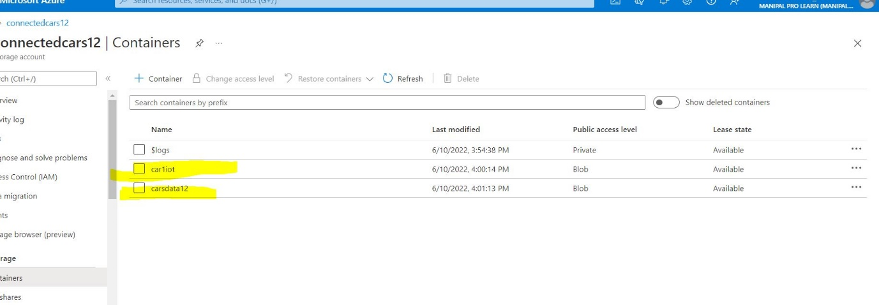
Creating a Storage Account:
Step1: Go to the azure portal.
Step2: open storage accounts and click on create
Step3: name the storage account and review it.
Step 4: after successful validation click on create.
Step5: our storage account creation is done.
Step6: open storage accounts and click on containers.and create a container.
Step7: name the container and give access level as blob.
and then create. It is the source folder.
Step8:same way create destination blob too and we can upload car data into the source blob storage.
Fig: Conformation Message

Slide 9
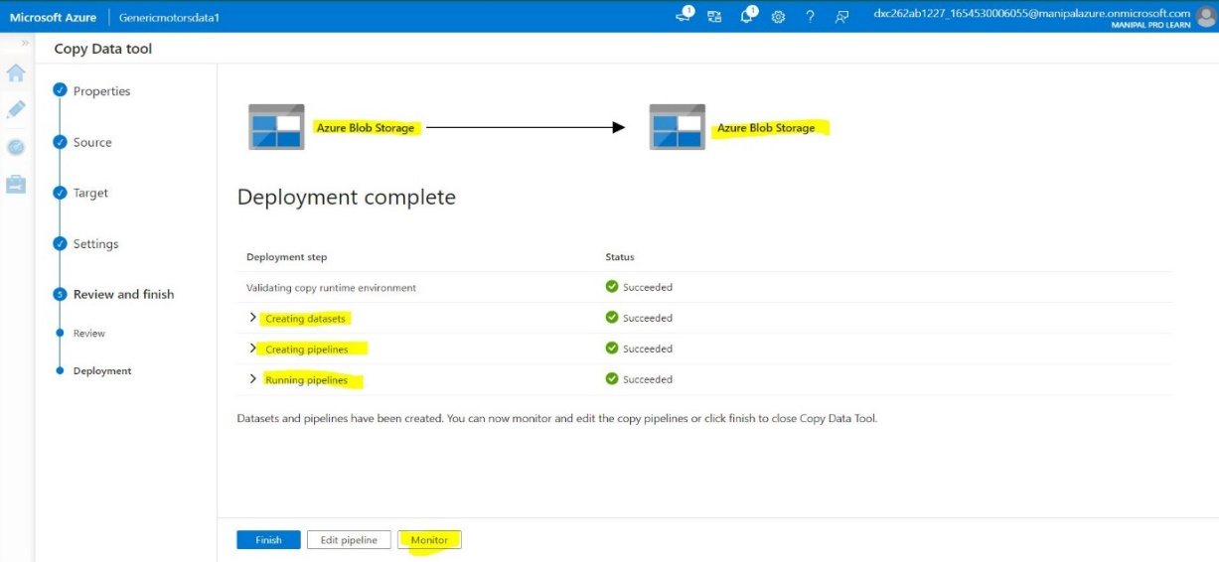
Practical Lab: Create ADF Pipeline End to end pipeline with triggers enabled:
Step1:Open the Homepage pf the data Factory.
Step 2: Go to data factory home page and click on injest data.
Step 3: select Built-in-copy task and run once now. Then click next.
Step 4: select source type and click on new connection.
Step 5: give the storage account details and test the connection.
Step 6: after the connection is successful click on create.
Step 7: now select the source folder and click ok
Step 8: Then click on Next.
Step 9: select the file format and other settings
Step 10: select the destination settings and update the information.
Step11: we can see the summary of the pipeline and click on next
And then run.
Fig: Conformation Message

Slide 10
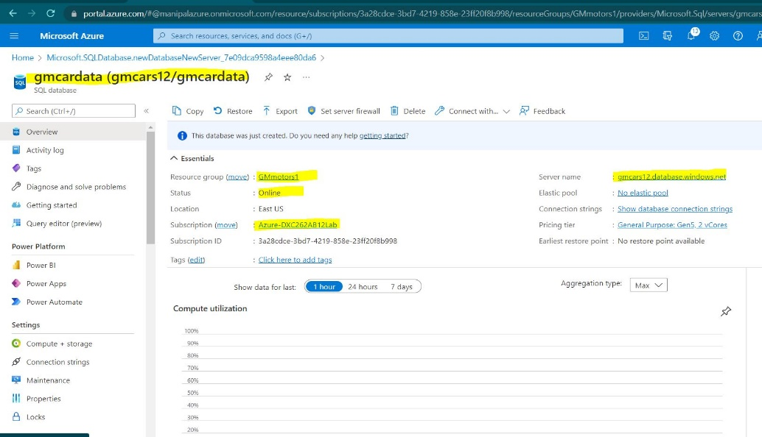
Create Azure SQL Server and Database:
Step1: got to portal.azure.com and search azure SQL.
Step2: open the home screen of azure SQL and click on create.
Step3: select SQL databases and click on Create.
Step4: select the resource group and give name to the data base.
Step5: Click on Networking
Step6: click on review and create.
Step7: your SQL data base is created.
Fig: Conformation Message

Slide 11
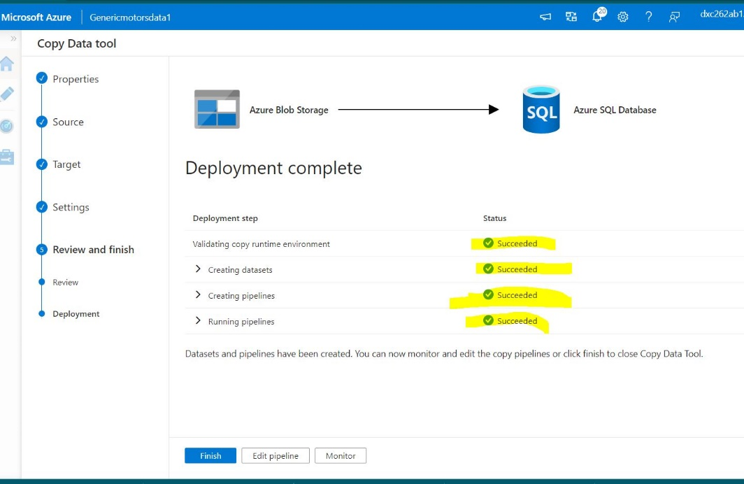
Practical Lab: Add another pipelines for moving data from Staging to SQL DB:
Step1: Go to the data factory studio and click on injest.
Step2: click on Built-in-copy task , run once and click next.
Step3: select the source type and the connection and select file folder.
Step4: Select the destination data store as Azure SQL
Step5: Click on new connection. Select the server name , database name , authentication type , give username and password. While checking the connection make sure that you allow the IP address of the pipeline will be allowed by the firewall of the database.
Step6: click on next.
Step7: review and click on next.
Step8: we can review the pipeline and then click on next.
Step9: The pipeline deployment is completed.
Fig: Conformation Message

Slide 12
Project outcomes :
Created a resource group for GM motors and also a storage account.
Created Azure Data Factory Account .
Created ADF Pipeline.
Created Azure blob trigger logic
Created Azure SQL Server and Database
Added pipeline for moving data from Staging to SQL DB
Link: https://drive.google.com/file/d/1YnUwjQ113FvWJb-gEXQ1aQdyoI5JAZ-W/view?usp=sharing

Slide 13
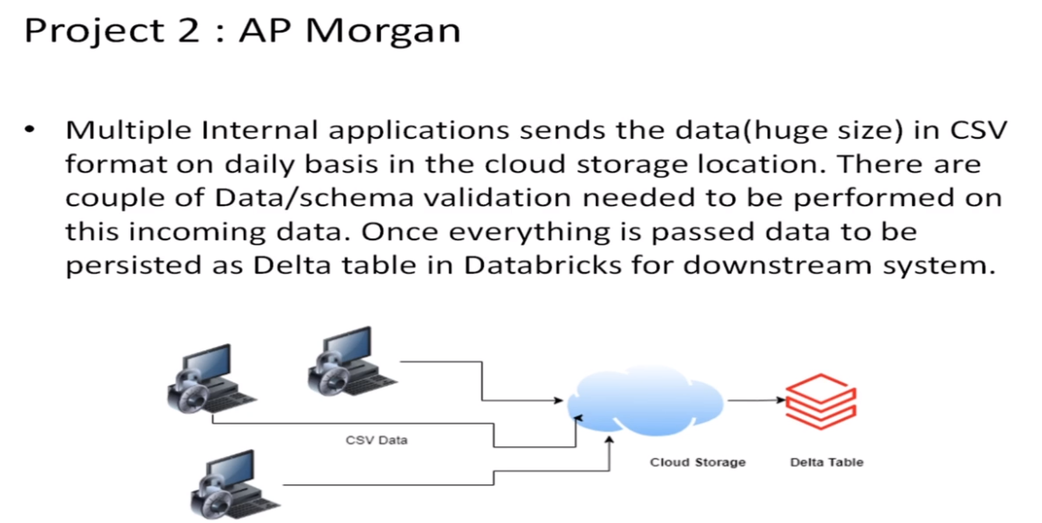

Slide 14
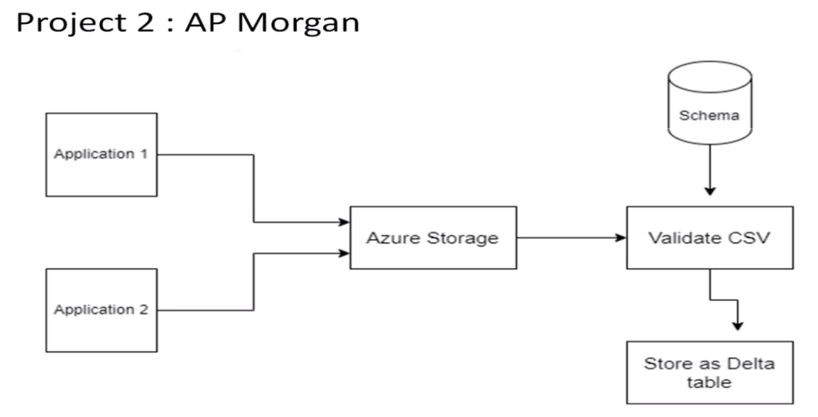
Project Overview
AP Morgan- High Level Detail
• Internal Application sends CSV file in Azure data lake storage.
Validation needed to apply on this follows:
Check for duplicate rows. If it contains duplicate rows, file need to be rejected.
Need to validate the date format for all the date fields. Date column names and desired date format is stored in a Azure SQL server.
If validation fails file will be rejected.
• Move all the rejected files to Reject folder.
• Move all the passed files to Staging folder.
• Write the passed files as the Delta table in the Azure
Data bricks
Fig: Architecture of project.

Slide 15
Client requirements :
Data bricks account.
Cluster in Azure Data bricks.
Notebook in Data bricks to Implement the Business Logic.
Azure Data Factory For AP Morgan.
Azure Data bricks Linked Service in ADF.

Slide 16
What is Data Bricks? :
It is the Microsoft implementation of apache spark.
Data bricks offers an integrated platform simplifying working with Apache Spark.
users of Data bricks can collaborate with Notebooks, set-up shared data integrations and clusters.
The Data bricks is commonly used for the big data processing and AI.
Data engineers and Data Scientists can set-up real-time data pipeline, run data mining, schedule data jobs and much more.

Slide 17
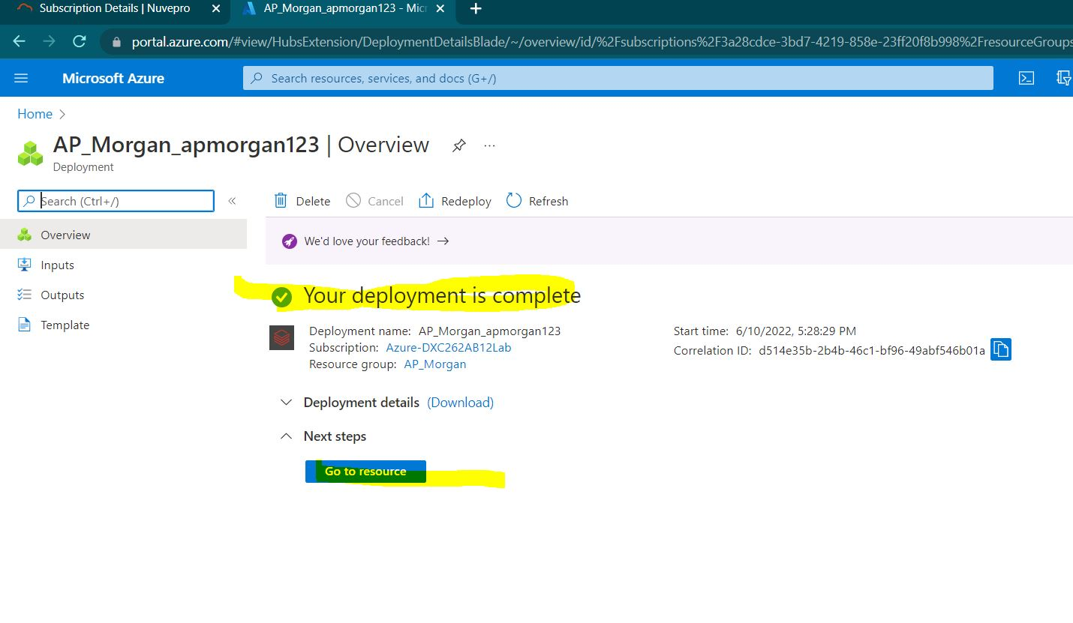
Practical Lab: Create a Data bricks :
Step1: Goto portal.azure.com and search for azure data bricks.
Step2: click on create button.
Step3: Create a new resource group for the AP morgan group.
Step4: give the name for the workspace and choose pricing tier as trial and later click on review and create.
Step5: after successful validation click on create button.
Step6: the deployment of the data bricks has been completed.
Fig: Conformation Message

Slide 18
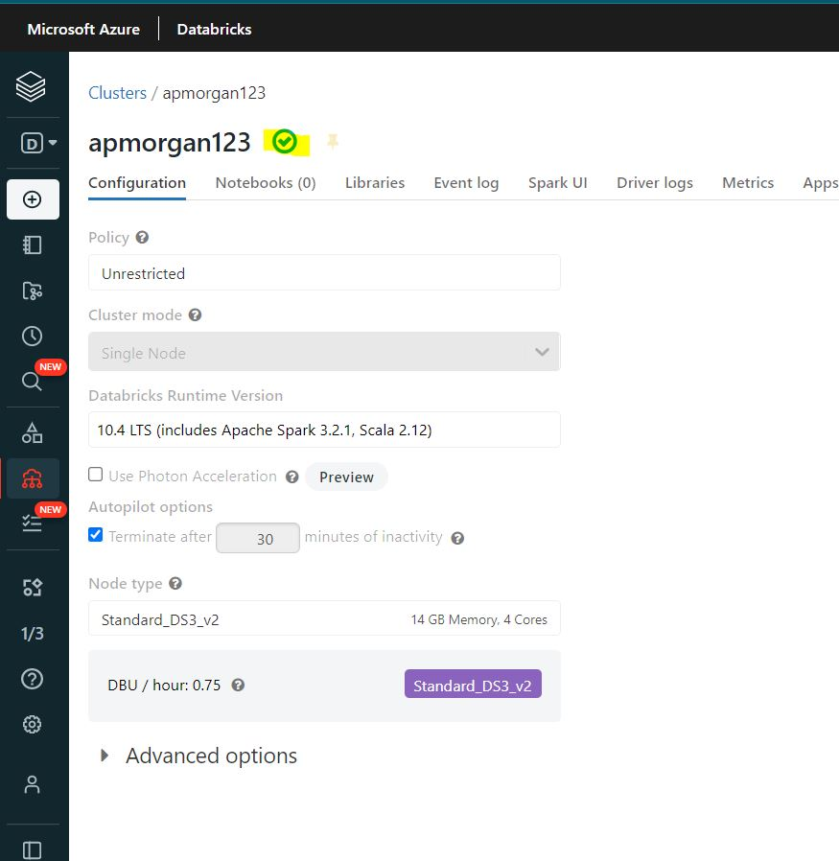
Practical Lab: Create Cluster in Azure Data bricks
Step1: goto overview of the data bricks deployment and click on launch workspace.
Step2: choose an account to sign into the data bricks workspace
Step3:Click on the create button in the menu and click on cluster
Step4: name the cluster, choose your required cluster mode and set termination time , then on create button.
Step5: after successful creation of the cluster the green tick mark appears near the cluster name.
Fig: Conformation Message

Slide 19
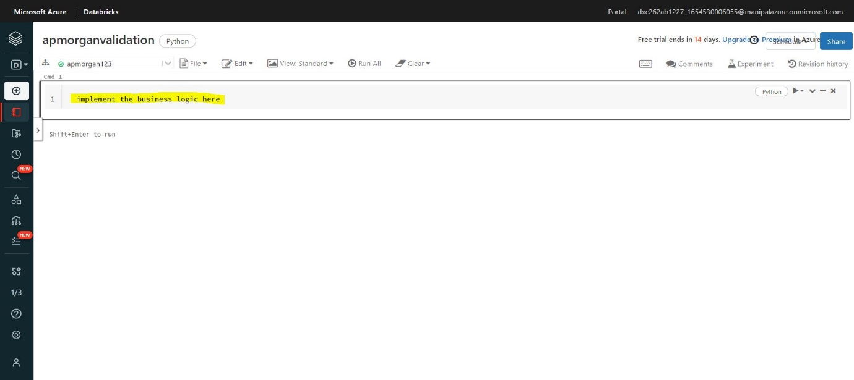
Practical Lab: Add notebook in Databricks and Implement the Business Logic :
Fig: Conformation Message
Step1: Go to create in the data bricks workspace.
Step2: select notebook.
Step3: name the notebook and assign the cluster to it.
Step4: You can now implement your business logic in the notebook provided.

Slide 20
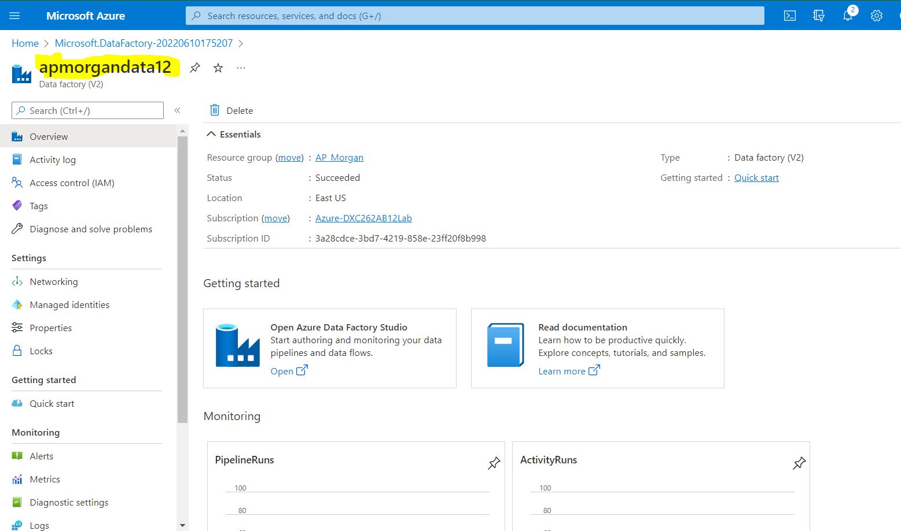
Practical Lab: Azure Data Factory For AP Morgan:
Step1: Goto portal.azure.com and search data factories.
Step2: click on the create button.
Step3: give the project details as well as the instance details and click on git configuration.
Step4: click on configure git later and later review and create.
Step5: after successful validation click on create button.
Step6: your data factory is created.
Fig: Conformation Message

Slide 21
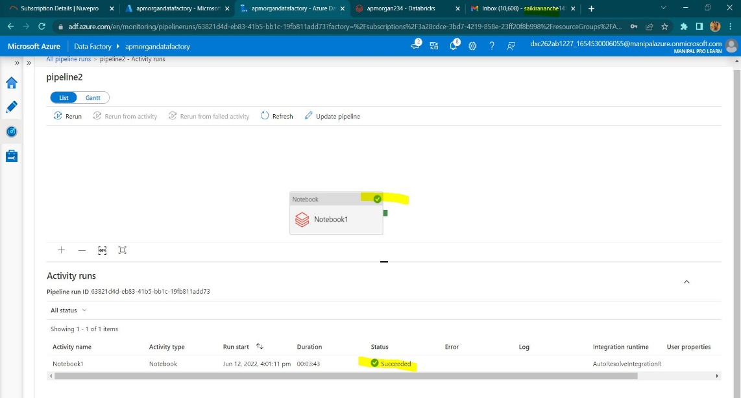
Practical Lab: Create Azure Databricks Linked Service in ADF:
Step1: open the overview page of the data factory and click on the azure data factory studio.
Step2: Click on compose button.
Step3: click on the + symbol
Step4: click on pipeline> choose pipeline again
Step5: Choose data bricks, Notebook under the activities.
Step6: drag and drop the notebook in the space provided.
Step7: click on azure data bricks and select the new option near data bricks linked service.
Step8: select the workspace, azure subscription, data bricks workspace URL. Select authentication type as Access token.
Fig: Conformation Message

Slide 22

Practical Lab: Create Azure Databricks Linked Service in ADF:
Step11: give the life time of the token and click on generate.
Step12: copy the generated access token.
Step13: put the access token and select cluster version,cluster node type, version etc and test the connection.
Step14: after the connection gets success click on create.
Step15: select the proper path of the notebook.
Step16: publish the pipeline in-order to save.
Step17: trigger the pipeline by clicking on add trigger >trigger now.
Step18: You can see the notification running.
Step19: you can see your pipeline run by opting the monitor option in the DF and hence the azure data bricks based ADF service is created.
Fig: Conformation Message

Slide 23
Project outcomes :
Created a resource group for AP Morgan group and also a storage account.
Created a Data bricks service for AP Morgan group .
Created a Cluster in Azure Data bricks.
Added a notebook in Data bricks to Implement the Business Logic.
Azure Data Factory For AP Morgan group have been created.
Created Azure Data bricks Linked Service in ADF for the AP Morgan Group.
Link: https://drive.google.com/file/d/1YnUwjQ113FvWJb-gEXQ1aQdyoI5JAZ-W/view?usp=sharing

Slide 24
Result:
Most of the project requirements have been fulfilled by the step by step procedures . Below is the URL for the entire documentation of the project.
Link: https://drive.google.com/file/d/1YnUwjQ113FvWJb-gEXQ1aQdyoI5JAZ-W/view?usp=sharing

Slide 25
Conclusions:
All the cases have been sloved successfully, it was so challenging when few of the pipelines got failed at first. After referring the error messages I’m able to run the pipelines successfully and had a great experience while learning the concepts in deep. Apart of the demonstrations that were explained in the tutorials I’m able to perform a variety of new operations with a lot of enthusiasm and engagement in learning.

Slide 26
